Slide 1

高级英语
基础精讲四
2.9.5下册第九课第5段

Slide 2

1.1.2.9永不脱离黑人区（I’ll Never Escape the Ghetto)
2.9.5下册第九课第5段
So if I‘m not black enough, and if I’m not white enough, and if I‘m not man enough, then tell me, Tony, what am I？
如果我不够黑，也不够白，甚至也不够男人，那么托尼你告诉我，我到底是什么人。

Slide 3
1.1.2.9永不脱离黑人区（I’ll Never Escape the Ghetto)
2.9.5下册第九课第5段
目录
一、课文带读（下册 Lesson 9）
二、题型讲解——选词填空

Slide 4
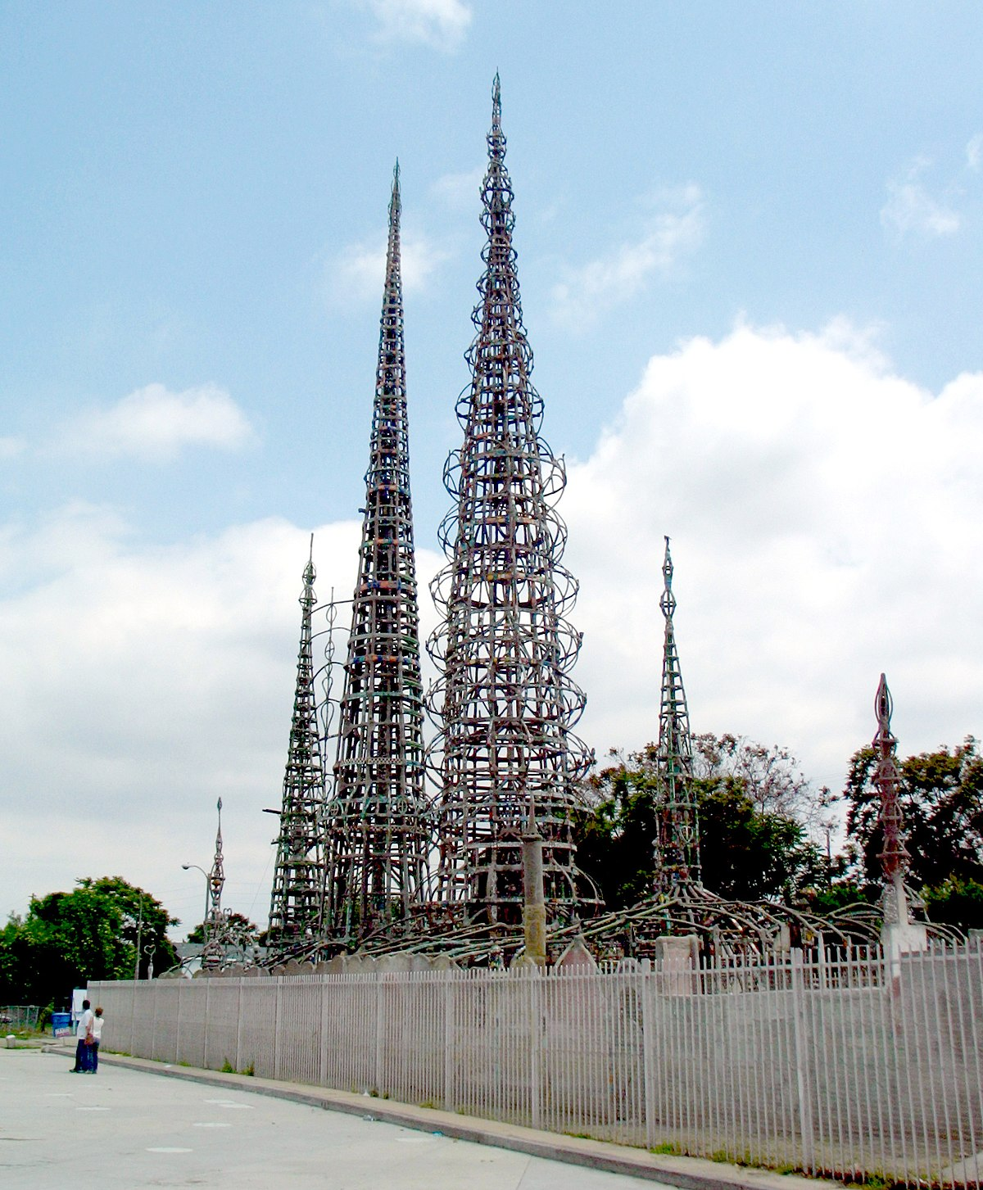
2.9.5下册第九课第5段
I’ll Never Escape the Ghetto

Slide 5
2.9.5下册第九课第5段
I’ll Never Escape the Ghetto
永不脱离黑人区

Slide 6
2.9.5下册第九课第5段
一、高级英语课文精讲——下册 Lesson 9
Para5：My own state of mind（心态）, when I left Watts eight years ago to take up the freshman year（第一年） at Whittier College , was different. It was to me less of a departure（离开）; it was the stepping off（出发） point of an Odyssey that was to take me through Whittier College and Oxford University, to Yale Law School , and back to Watts. I had intended（计划） then, as now , to make Watts my home.
Watts：瓦茨，洛杉矶南部的黑人区
Whittier College：惠蒂尔学院，是一美国私立的文化艺术大学。
Odyssey：《奥德赛》，其中描写了奥德赛在特洛伊战争后十年内辗转回家的种种经历，引申为漫长的旅途。

Slide 7
2.9.5下册第九课第5段
一、高级英语课文精讲——下册 Lesson 9
freshman
sophomore
junior
senior
大一学生
大二学生
大三学生
大四学生

Slide 8


2.9.5下册第九课第5段
Brown
布朗大学
Columbia
哥伦比亚大学
Cornell
康奈尔大学
Dartmouth
达特茅斯学院
Harvard
哈佛大学
Pennsylvania
宾夕法尼亚大学
Princeton
普林斯顿大学
Yale
耶鲁大学

Slide 9
2.9.5下册第九课第5段
一、高级英语课文精讲——下册 Lesson 9
Para5：My own state of mind（心态）, when I left Watts eight years ago to take up the freshman year（第一年） at Whittier College , was different. It was to me less of a departure（离开）; it was the stepping off（出发） point of an Odyssey that was to take me through Whittier College and Oxford University, to Yale Law School , and back to Watts. I had intended（计划） then, as now , to make Watts my home.
八年前，我离开瓦茨到惠蒂尔学院读一年级时心态和他们不同，对于我，与其说这是离别，还不如说是一次漫长历程的出发点，它将带我从惠蒂尔学院，牛津大学，耶鲁法学院，再回到瓦茨。 我当时和现在一样打算把瓦茨当作自己的家。

Slide 10
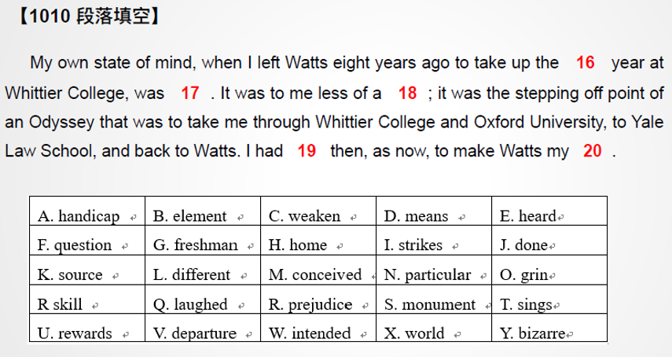
2.9.5下册第九课第5段
练习

Slide 11
2.9.6下册第九课第6段
一、高级英语课文精讲——下册 Lesson 9
Para6：The talk among the ambitious（有野心的） and future-minded（有远见的） youth in Watts was on getting out so that careers（职业生涯） could begin. And they did just that . The talented young people left Watts in droves（成群结队）. The one skill they had in common（公共的，共有的） was the ability to escape the ghetto.

Slide 12
2.9.6下册第九课第6段
一、高级英语课文精讲——下册 Lesson 9
Para6：The talk among the ambitious（有野心的） and future-minded（有远见的） youth in Watts was on getting out so that careers（职业生涯） could begin. And they did just that . The talented young people left Watts in droves（成群结队）. The one skill they had in common（公共的，共有的） was the ability to escape the ghetto.
在瓦茨，有抱负、有远见的年青人谈论的是走出黑人区，开始干一番事业。他们正是这样做的。有才能的年青人成群结队离开瓦茨，他们共同拥有的本领是脱离黑人区的能力。

Slide 13
2.9.7下册第九课第7段
一、高级英语课文精讲——下册 Lesson 9
Para7：I was especially intrigued（引起很大兴趣） by a career in Watts because it was supposed to be impossible. I wanted to demonstrate（证明）that it could be done more than anything else. I recall（回想起） a moment during a city-wide（全市范围内的） high school oratorical contest（演讲比赛） when one of the judges（裁判，评委） asked whether anything good could come out of Watts. Our high school won the contest. We showed that judge. I saw that achievement as a possible pattern（榜样，模式） for the entire（整个的） ghetto. I was pleased.
Notes:
[ˈdɛmən ˌstret]
oratorical
[ˌɔrəˈtɔrɪkl]

Slide 14
2.9.7下册第九课第7段
一、高级英语课文精讲——下册 Lesson 9
Para7：I was especially intrigued（引起很大兴趣） by a career in Watts because it was supposed to be impossible. I wanted to demonstrate（证明）that it could be done more than anything else. I recall（回想起） a moment during a city-wide（全市范围内的） high school oratorical contest（演讲比赛） when one of the judges（裁判，评委） asked whether anything good could come out of Watts. Our high school won the contest. We showed that judge. I saw that achievement as a possible pattern（榜样，模式） for the entire（整个的） ghetto. I was pleased.
我对在瓦茨做一番事业特别感兴趣，因为人们认为这是件不可能的事，我想证明这是能够做到的，而且可以做得更好。我想起有一次全市中学演讲比赛，一个评委问瓦茨有没有什么好东西。我们学校赢得了比赛。我们向那个评委证实了自己的能力。我把那次成功看作整个黑人区可以仿效的榜样。我很高兴。

Slide 15
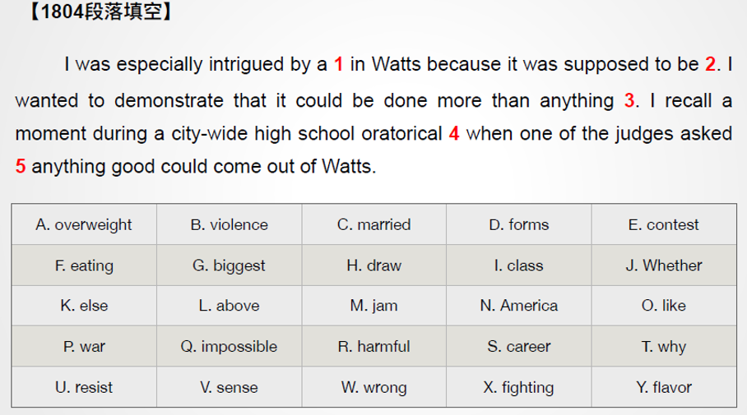
2.9.7下册第九课第7段
练习

Slide 16
2.9.14下册第九课第14段
一、高级英语课文精讲——下册 Lesson 9
Para14：My own lack（缺少） of shame（羞愧） in the rioting（暴乱） then taking place（发生） in America surprised me. In one sense（在某种意义上）, I was the archetype（典型） of the ghetto child who through hard work and initiative (主动性) was pulling himself toward a better life. I was the example, the exception（例外）. It was my life that was held up（推举） to Watts youth to emulate(效仿，模仿) .
Notes:
lack

Slide 17
2.9.14下册第九课第14段
一、高级英语课文精讲——下册 Lesson 9
Para14：My own lack（缺少） of shame（羞愧） in the rioting（暴乱） then taking place（发生） in America surprised me. In one sense（在某种意义上）, I was the archetype（典型） of the ghetto child who through hard work and initiative (主动性) was pulling himself toward a better life. I was the example, the exception（例外）. It was my life that was held up（推举） to Watts youth to emulate(效仿，模仿) .
我对美国正在发生的暴乱并不感到羞愧，这使我很吃惊。我是通过勤奋努力和主动精神使自己的生活得以改善的黑人区后代的典范。我是个榜样，也是个例外。我的生活成为瓦茨青年仿效的榜样。

Slide 18
2.9.15下册第九课第15段
一、高级英语课文精讲——下册 Lesson 9
Para15：In another sense（从另一方面）, however, my feelings toward the rioting were predictable (预料之中的). I had always been bothered by the passivity（消极被动） of the ghetto. The majority（大多数，主要部分） of black men in the North had remained outside the struggle. Nothing was happening in the ghettos. No one was making it happen.
Notes:
Representative 有代表性的

Slide 19
2.9.15下册第九课第15段
一、高级英语课文精讲——下册 Lesson 9
Para15：In another sense（从另一方面）, however, my feelings toward the rioting were predictable (预料之中的). I had always been bothered by the passivity（消极被动） of the ghetto. The majority（大多数，主要部分） of black men in the North had remained outside the struggle. Nothing was happening in the ghettos. No one was making it happen.
然而，在另一方面，我对暴乱的感受是在意料之中的。黑人区的消极顺从向来使我困扰。北方大多数黑人一直不参与斗争，黑人区里一切平平静静，没有人 打破这种平静。

Slide 20
2.9.15下册第九课第15段
一、高级英语课文精讲——下册 Lesson 9
Para15：Ghetto rioting then was the first representation (代表，表现) I perceived（察觉到） of movement and activity among the mass（大量） of Negroes（黑人） in the North. It marked a break with the passive tradition of dependency（依赖） and indifference (冷漠). The ghetto was at least no longer（不再） content with（满足于） its status（社会地位） as bastard child（私生子） of urban（都市的） America. The currents set in motion（涌动的急流） had a hopeful , irreversible（不可逆转的） quality about them. The ghetto wanted legitimation（合法化）. That was a beginning.
Notes:
Representative 有代表性的
[ˌɪrɪˈvɜrsəbl]

Slide 21
2.9.15下册第九课第15段
一、高级英语课文精讲——下册 Lesson 9
Para15：Ghetto rioting then was the first representation (代表，表现) I perceived（察觉到） of movement and activity among the mass（大量） of Negroes（黑人） in the North. It marked a break with the passive tradition of dependency（依赖） and indifference (冷漠). The ghetto was at least no longer（不再） content with（满足于） its status（社会地位） as bastard child（私生子） of urban（都市的） America. The currents set in motion（涌动的急流） had a hopeful , irreversible（不可逆转的） quality about them. The ghetto wanted legitimation（合法化）. That was a beginning.
黑人区的暴乱是我看到的北方黑人群众中行动和活力的首次表现。标志着依赖和冷漠这一消极传统终结。黑人区至少已经不再满足于自己作为美国城市私生子的身份，这些涌动起来的急流有着充满希望、不可逆转的特点。黑人区需要取得合法的地位，这只是一个开始。
Notes:
[ˌɪrɪˈvɜrsəbl]
legislation

Slide 22
2.9.20下册第九课第20段
一、高级英语课文精讲——下册 Lesson 9
Para20：The new intellectual climate（气氛） in Watts was hard –wrought（得来不易的）. It was rich enough to support even a communist（共产主义者） bookstore. Writers , poets , artists flourished（繁荣，活跃）. I was handed full manuscripts（手稿） of unpublished（未出版的） books by indigenous（本土的） writers and asked to criticize them. I have not seen during eight years of college life as many personal journals（日记） kept and sketches（草稿） written as in Watts since the 1965 riots. A new , rough（粗糙的） wisdom（智慧） of the street corner（角落） was emerging（浮现）.

Slide 23
2.9.20下册第九课第20段
一、高级英语课文精讲——下册 Lesson 9
Para20：The new intellectual climate（气氛） in Watts was hard –wrought（得来不易的）. It was rich enough to support even a communist（共产主义者） bookstore. Writers , poets , artists flourished（繁荣，活跃）. I was handed full manuscripts（手稿） of unpublished（未出版的） books by indigenous（本土的） writers and asked to criticize them. I have not seen during eight years of college life as many personal journals（日记） kept and sketches（草稿） written as in Watts since the 1965 riots. A new , rough（粗糙的） wisdom（智慧） of the street corner（角落） was emerging（浮现）.
新的理性氛围在瓦茨艰难地形成了。内容丰富多彩，甚至足以维持一家专卖 共产主义书籍的书店。作家、诗人、艺术家异常活跃。本地作者把未出版的完整书稿交给我，要我评论。从1965年暴乱以来，在瓦茨有这么多人记日记，写随笔，这是我在八年的大学生涯中从未见到过的。一种新型的、粗扩的街头文化正在形成。
Notes:
Communist 共产主义者 community 社区

Slide 24
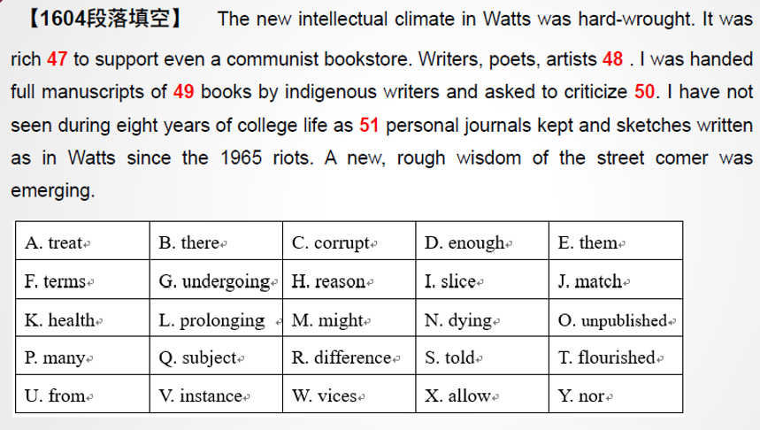
2.9.20下册第九课第20段
练习

Slide 25
2.9.24下册第九课第24段
一、高级英语课文精讲——下册 Lesson 9
Para24：There is a difference between my schooling and the wisdom of the street corner. I know the life of a black man in Watts is larger than a federal poverty program（联邦的扶贫计划）. If there is no future for the black ghetto , the future of all Negroes is diminished（减少）. What affects it , affects me , for I am a child of the ghetto. When they do it to Watts, they do it to me, too. I‘ll never escape from the ghetto. I have staked（以…下注，打赌） my all on its future. Watts is my home.

Slide 26
2.9.24下册第九课第24段
一、高级英语课文精讲——下册 Lesson 9
Para24：There is a difference between my schooling and the wisdom of the street corner. I know the life of a black man in Watts is larger than a federal poverty program（联邦的扶贫计划）. If there is no future for the black ghetto , the future of all Negroes is diminished（减少）. What affects it , affects me , for I am a child of the ghetto. When they do it to Watts, they do it to me, too. I‘ll never escape from the ghetto. I have staked（以…下注，打赌） my all on its future. Watts is my home.
我受的学校教育和街头文化之间存在差别。我知道瓦茨黑人生活中的问题远非任何联邦救贫计划所能解决的。如果黑人区没有前途，所有黑人的前途也会渺茫。任何影响黑人区的事物都影响着我，因为我是黑人区的孩子。他们恶待瓦茨时，也就是恶待我。我永远不会脱离黑人区。我的一切与黑人区的未来休戚相关。 瓦茨是我的家。

Slide 27
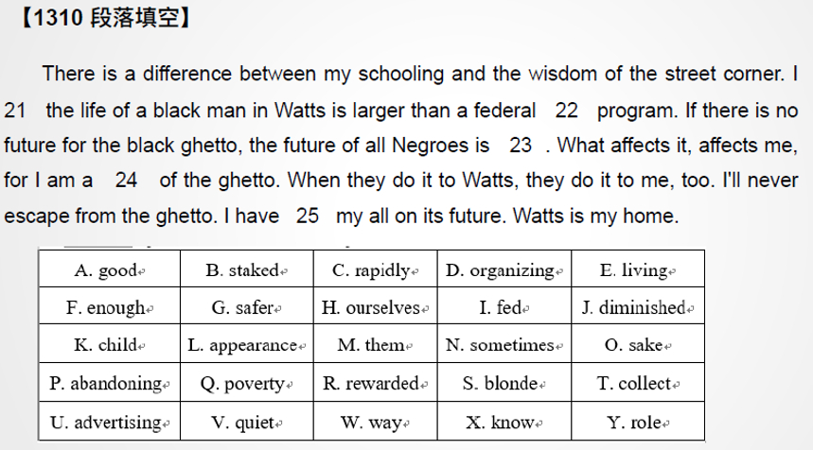
2.9.24下册第九课第24段
练习

Slide 28
2.9.25下册第九课第25段
目录
一、课文带读（上册 Lesson 2）
二、题型讲解——汉译英

Slide 29
2.9.25下册第九课第25段
1、单项选择
2、阅读理解
3、英译汉
高级英语
4、写作
5、选词填空
6、汉译英

Slide 30
2.9.25下册第九课第25段
1、单项选择
2、阅读理解
3、英译汉
高级英语
4、写作
5、选词填空
6、汉译英

Slide 31
2.9.25下册第九课第25段
二、题型讲解——汉译英
1. 句型：五大基本句型
2. 选词：尽量选择教材内的词
3. 造句：检查语法、拼写等错误
汉译英

Slide 32
2.9.25下册第九课第25段
二、题型讲解——汉译英
1. 句型：五大基本句型
2. 选词：尽量选择教材内的词
3. 造句：检查语法、拼写等错误
汉译英

Slide 33
2.9.25下册第九课第25段
二、题型讲解——汉译英
1. 句型：五大基本句型
2. 选词：尽量选择教材内的词
3. 造句：检查语法、拼写等错误
汉译英原则

Slide 34
2.9.25下册第九课第25段
二、题型讲解——汉译英
1. 句型：五大基本句型
主+谓
主+谓+宾
主+谓+宾+宾
主+谓+宾+宾补
主+系+表

Slide 35
2.9.25下册第九课第25段
二、题型讲解——汉译英
1. 句型：五大基本句型
主+谓
主+谓+宾
主+谓+宾+宾
主+谓+宾+宾补
主+系+表
I sleep.
I eat an apple.
My mom gave me an apple.
I made my life better.
I am fine.

Slide 36
2.9.25下册第九课第25段
二、题型讲解——汉译英
1. 句型：五大基本句型
2. 选词：尽量选择教材内的词
3. 造句：检查语法、拼写等错误
汉译英原则

Slide 37
2.9.25下册第九课第25段
二、题型讲解——汉译英
逐字翻译
2. 调整语序
3. 选择适当语法
汉译英方法

Slide 38
2.9.26下册第九课第26段
二、题型讲解——汉译英
例1.如果昨晚没熬夜的话，他今天就不会睡过头了。

Slide 39
2.9.26下册第九课第26段
二、题型讲解——汉译英
例1.如果昨晚没熬夜的话，他今天就不会睡过头了。
If last night not stay up ，he today not oversleep

Slide 40
2.9.26下册第九课第26段
二、题型讲解——汉译英
例1.如果昨晚没熬夜的话，他今天就不会睡过头了。
If last night not stay up ，he today not oversleep
If he did not stay up last night，he will not oversleep.

Slide 41
2.9.26下册第九课第26段
二、题型讲解——汉译英
例1.如果昨晚没熬夜的话，他今天就不会睡过头了。
If 条件句
If he doesn’t hurry up, he will miss the bus.
If I knew his number, I would tell you.

Slide 42
2.9.26下册第九课第26段
二、题型讲解——汉译英
例1.如果昨晚没熬夜的话，他今天就不会睡过头了。
If 条件句
If he doesn’t hurry up, he will miss the bus. （真实）
If I knew his number, I would tell you. （虚拟）

Slide 43
2.9.26下册第九课第26段
二、题型讲解——汉译英
例1.如果昨晚没熬夜的话，他今天就不会睡过头了。
If 条件句
虚拟：
与现在事实相反：if +过去式，would/should/could/might +动词原形
If I knew his number, I would tell you.
与过去事实相反：if +had done，would/should/could/might + have done
If I had got there earlier，I could have met her.

Slide 44
2.9.26下册第九课第26段
二、题型讲解——汉译英
例1.如果昨晚没熬夜的话，他今天就不会睡过头了。
If last night not stay up ，he today not oversleep
If he did not stay up last night，he will not oversleep.
If he had not stayed up last night, he would not have overslept this morning.

Slide 45
2.9.26下册第九课第26段
二、题型讲解——汉译英
例2. 每当听到那首歌时，我都会回想起童年的经历。

Slide 46
2.9.26下册第九课第26段
二、题型讲解——汉译英
例2. 每当听到那首歌时，我都会回想起童年的经历。
Every time hear that song, I recall childhood experience

Slide 47
2.9.26下册第九课第26段
二、题型讲解——汉译英
例2. 每当听到那首歌时，我都会回想起童年的经历。
Every time hear that song, I recall childhood experience
Every time I hear that song, I recall the experiences of my childhood.

Slide 48
2.9.26下册第九课第26段
二、题型讲解——汉译英
例2. 每当听到那首歌时，我都会回想起童年的经历。
Every time hear that song, I recall childhood experience
Every time I hear that song, I recall the experiences of my childhood.
Every time I hear that song, I will recall the experiences of my childhood.

Slide 49
2.9.26下册第九课第26段
二、题型讲解——汉译英
例2. 每当听到那首歌时，我都会回想起童年的经历。
Every time hear that song, I recall childhood experience
Every time I hear that song, I recall the experiences of my childhood.
Every time I hear that song, I will recall the experiences of my childhood.
Every time hearing that song, I will recall the experiences of my childhood.

Slide 50
2.9.26下册第九课第26段
二、题型讲解——汉译英
例3. 但十几亿年来，人们一直是根据味道来进食的。（1710）

Slide 51
2.9.26下册第九课第26段
二、题型讲解——汉译英
例3. 但十几亿年来，人们一直是根据味道来进食的。（1710）
But a billion years， people all the time according to flavor eat

Slide 52
2.9.26下册第九课第26段
二、题型讲解——汉译英
例3. 但十几亿年来，人们一直是根据味道来进食的。（1710）
But a billion years， people all the time according to flavor eat
But since a billion years， people eat food according to the flavor all the time.

Slide 53
2.9.26下册第九课第26段
二、题型讲解——汉译英
例3. 但十几亿年来，人们一直是根据味道来进食的。（1710）
But a billion years， people all the time according to flavor eat
But since a billion years， people eat food according to the flavor all the time.
But people have been eating food according to the flavor all the time since a billion years ago.

Slide 54
2.9.26下册第九课第26段
二、题型讲解——汉译英
例3. 但十几亿年来，人们一直是根据味道来进食的。（1710）
But a billion years， people all the time according to flavor eat
But since a billion years， people eat food according to the flavor all the time.
But people have been eating food according to the flavor all the time since a billion years ago.
But people have been eating according to flavor for upwards of a billion years.

Slide 55
2.9.26下册第九课第26段
二、题型讲解——汉译英
例3. 但十几亿年来，人们一直是根据味道来进食的。（1710）
But people have been eating according to flavor for upwards of a billion years.

Slide 56
2.9.26下册第九课第26段
二、题型讲解——汉译英
例4. 我从小到大，早已经习惯了窗外只有草、天空和树木，习惯了周围几乎一片寂静，习惯了去追寻心之所向的一切（1810）

Slide 57
2.9.26下册第九课第26段
二、题型讲解——汉译英
例4. 我从小到大，早已经习惯了窗外只有草、天空和树木，习惯了周围几乎一片寂静，习惯了去追寻心之所向的一切（1810）
Since I grew up, been used to windows grass sky tree be enclosed in silence chase after what I want

Slide 58
2.9.26下册第九课第26段
二、题型讲解——汉译英
例4. 我从小到大，早已经习惯了窗外只有草、天空和树木，习惯了周围几乎一片寂静，习惯了去追寻心之所向的一切（1810）
Since I grew up, been used to windows grass sky tree be enclosed in silence chase after what I want
Since I grew up, I have been used to seeing out of my windows only grass, sky, tree, to being enclosed in almost complete silence and to chasing after what I really want in my heart.

Slide 59
2.9.26下册第九课第26段
二、题型讲解——汉译英
例4. 我从小到大，早已经习惯了窗外只有草、天空和树木，习惯了周围几乎一片寂静，习惯了去追寻心之所向的一切（1810）
课文原文：I have grown up accustomed to seeing out of my windows nothing but grass, sky, tree, to being enclosed in a ring of almost complete silence and to making journeys for anything that I want.
Notes:
Journay旅途，旅程

Slide 60
谢谢观看
See You
2.9.26下册第九课第26段

